Slide 1


Slide 2



Kaggle challenge
Predicting Passenger
Transport on
Spaceship Titanic
Amit Gurav-22024186
Dhavalkumar Pithadiya-22003118
Dhairyakumar Shah-22014212
Hassan Khan-21089475
Nalluri Vishnu Vardhan-22029582
GitHub Repositories
Collab Notebook
Image Reference: https://creator.nightcafe.studio/creation/neJ6WkwM4rNhSCoSr5Ub

Slide 3

The Spaceship Titanic, a passenger spaceship, hit a spacetime anomaly during its first trip.
CONTENT

Slide 4

The Spaceship Titanic, a passenger spaceship, hit a spacetime anomaly during its first trip.
Predict which passengers were transported to an alternate dimension.
CONTENT
TASK

Slide 5

The Spaceship Titanic, a passenger spaceship, hit a spacetime anomaly during its first trip.
Predict which passengers were transported to an alternate dimension.
Personal records recovered from the ship's damaged computer system.
CONTENT
TASK
DATA

Slide 6

The Spaceship Titanic, a passenger spaceship, hit a spacetime anomaly during its first trip.
Predict which passengers were transported to an alternate dimension.
Personal records recovered from the ship's damaged computer system.
Build a machine learning model to predict passenger transport based on features like age, room service, destination, etc.
CONTENT
TASK
DATA
OBJECTIVE

Slide 7
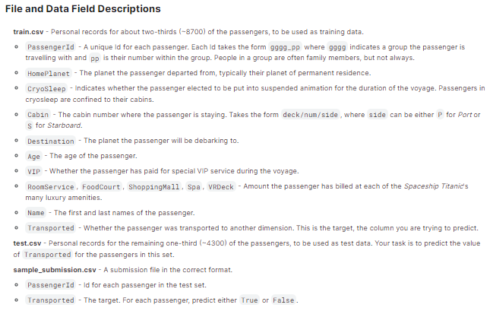
DATA OVERVIEW
Import the basic library
Imported the two main datasets which are train.csv and test.csv
Checked total number of missing values & their percentage in dataset

Slide 8
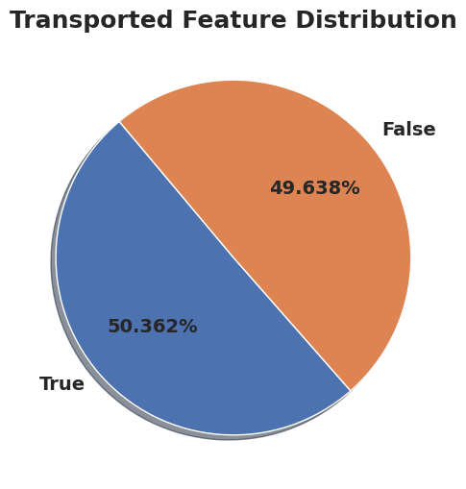
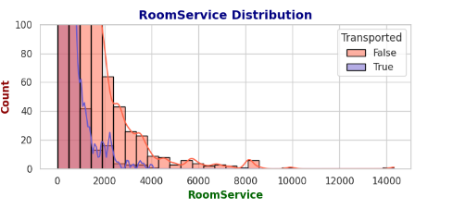
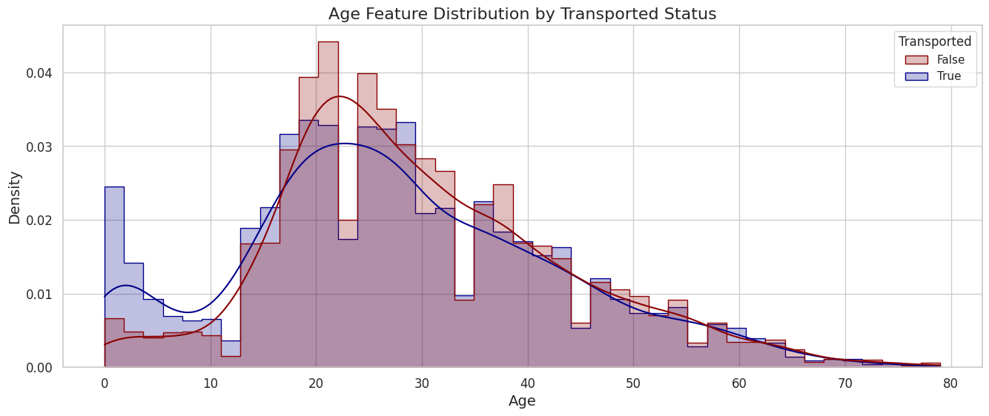
Exploratory Data Analysis (EDA)
The Transported feature is highly balanced.
Most passengers are aged 18-32. Passengers aged 0-18 are more likely to be transported, while those aged 18-32 are less likely.
Those over 32 are equally likely to be transported.
Many passengers have zero expenses, suggesting a new "No Spending" feature.

Slide 9
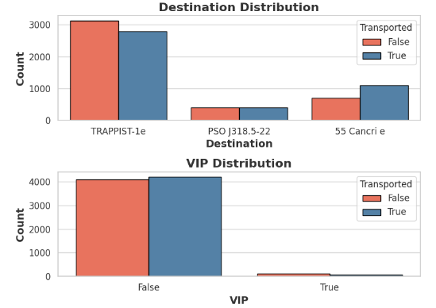
Exploratory Data Analysis (EDA) contd
Destination Analysis: The majority of passengers are traveling to Trappist-1e, indicating a notable trend in destination preferences among travelers.
VIP Feature Evaluation: One category significantly outweighs others in the VIP feature, potentially causing overfitting issues in our model and suggesting it may not be a beneficial feature.

Slide 10
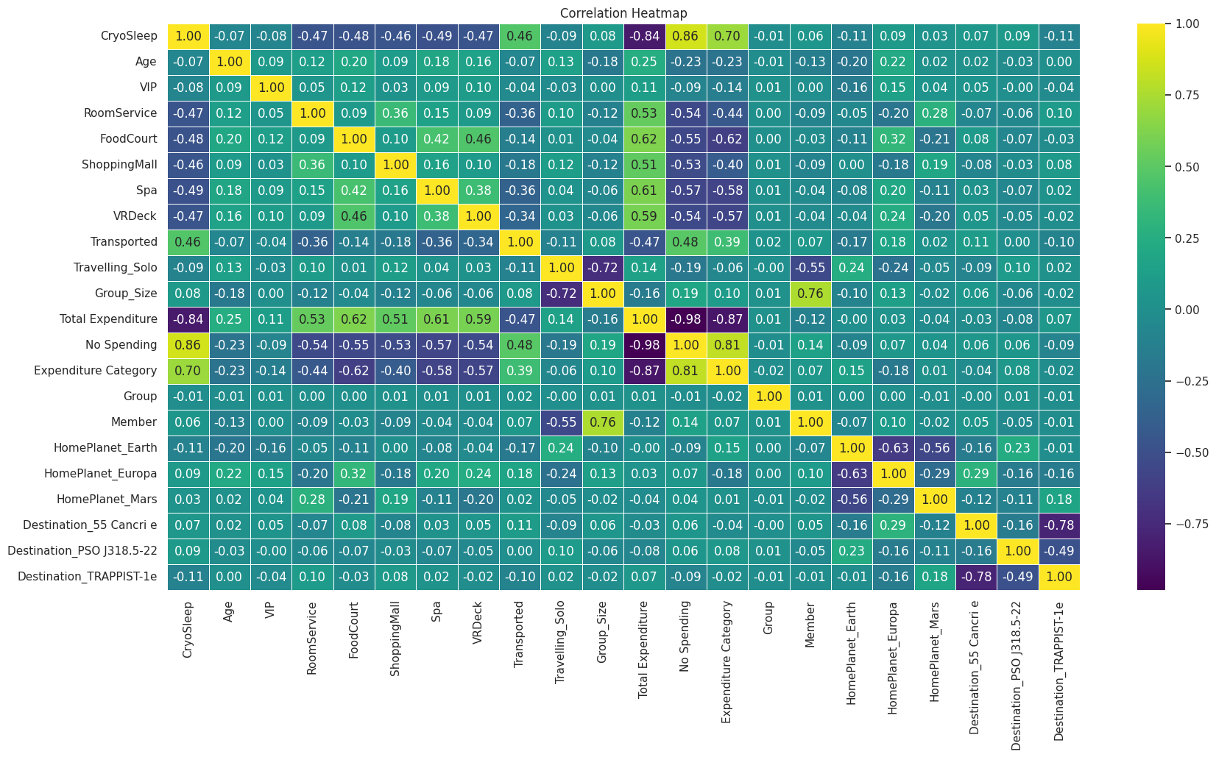
Data Preprocessing
Data cleaning is essential for preprocessing raw data, involving removing inconsistencies, imputing null values, and reducing outliers to identify characteristics and draw conclusions.
Important correlations.
Passengers who spend nothing have no total expenditure since there is a substantial negative correlation between spending and total expenditure (-0.98).
Traveling Solo and Group Size have a substantial negative correlation (-0.72), indicating that lone travelers do not belong to any groups.

Slide 11
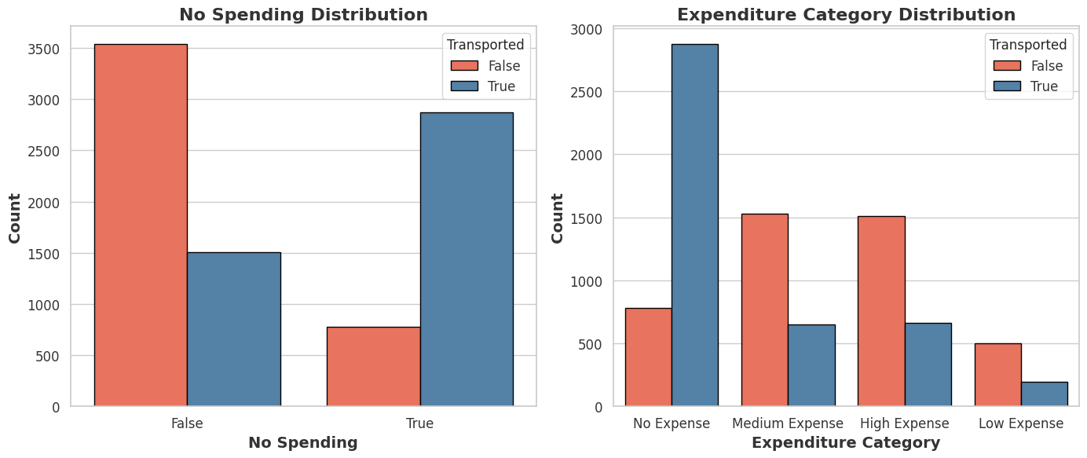
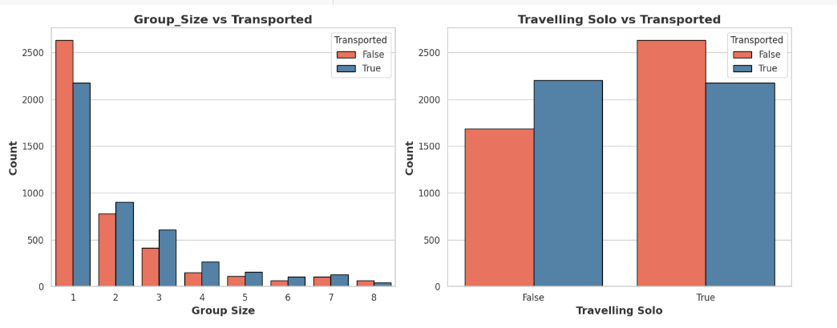
Data Preprocessing contd

Slide 12
Model Testing
Model | Positive | Negative | Accuracy
 |  |  | Training | Testing
Logistic Regression | Interpretable, fast training | Limited to linear relationships, may underperform with complex data | 77.207363 | 77.055779
Support Vector Machines (SVM) | Effective in high-dimensional spaces, clear margin of separation | Computationally intensive with larger datasets, less effective with overlap | 80.140926 | 78.263370
Decision Tree | Handles non-linear relationships, interpretable | Prone to overfitting, sensitive to small variations in data | 100.000000 | 71.707878
Random Forest | Reduces overfitting, handles missing data, good performance | Slower training compared to individual trees, need for tuning | 100.000000 | 78.263370
AdaBoost | Improves accuracy by focusing on difficult instances | Sensitive to noisy data, requires careful tuning | 79.838942 | 78.550891
XGBoost | Efficient with large datasets, strong predictive power, supports regularization | Requires careful hyperparameter tuning, potential for overfitting | 81.478286 | 78.090857
CatBoost | Efficient handling of categorical variables, reduces preprocessing needs | Slower compared to XGBoost in certain scenarios, requires tuning | 86.065574 | 79.068430

Slide 13
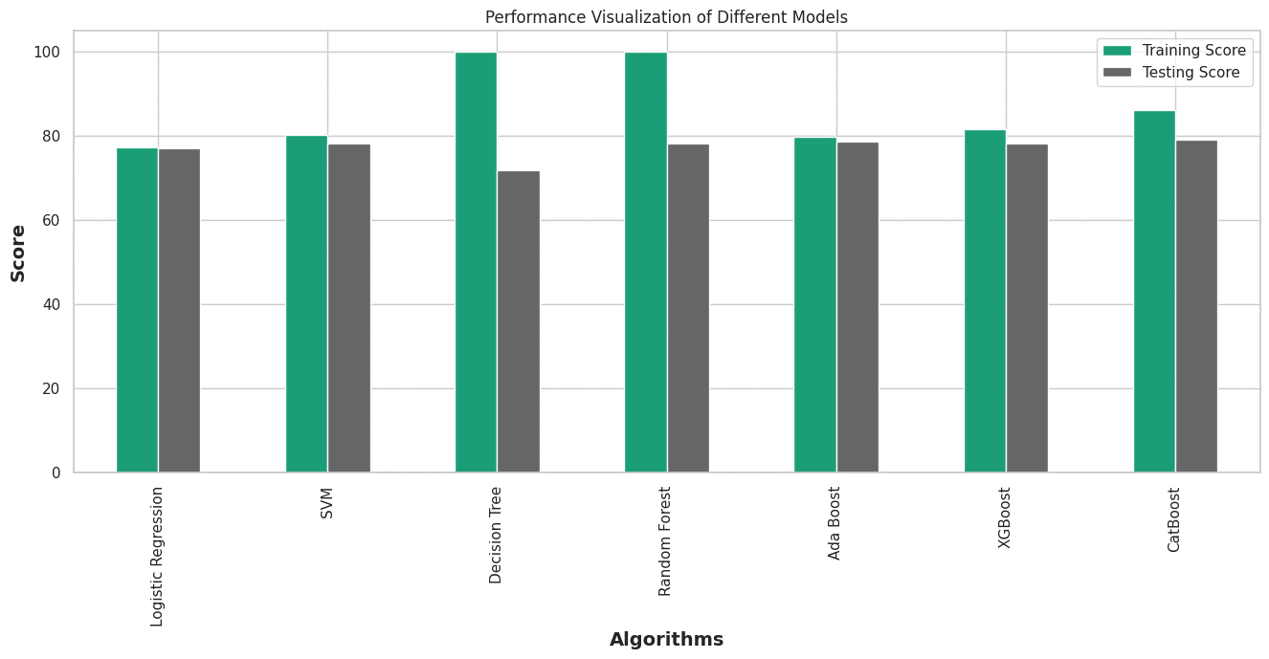
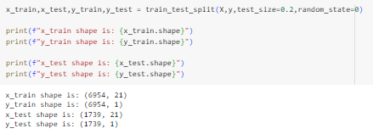
Model Comparison
Key Highlights:
The closer alignment of training and test scores indicates that CatBoost is more resistant against overfitting and has higher generalization than Random Forest.
While Random Forest attains an ideal training score, testing performance drops due to overfitting.
CatBoost offers competitive performance alongside better generalization capabilities, and it is more effective at handling categorical data.
Distrubuted scaled and unscaled data into two shapes: X-train & Y-train.

Slide 14
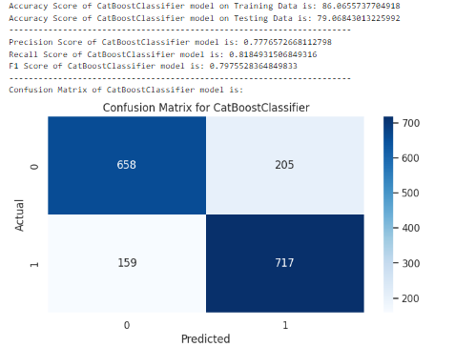
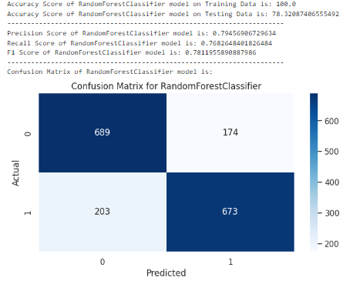
Results
Performance in Generalization:
Accuracy of CatBoost Testing: 79.07%
Accuracy of Random Forest Testing: 78.32%
Reason: When compared to Random Forest, CatBoost performs better on unseen data, as evidenced by its slightly greater testing accuracy.
Overfitting:
Accuracy of CatBoost Training: 86.07%
Accuracy of Random Forest Training: 100%
Reason: CatBoost's training accuracy is substantially closer to its testing accuracy and exhibits less overfitting. On the other hand, the flawless training accuracy of Random Forest implies a large overfitting.
Understanding Confusion Matrix:
CatBoost: False Negatives (1s inaccurately forecasted as 0s): 159 True Positives (1s accurately predicted): 717
Random Forest: False Negatives (1s inaccurately forecasted as 0s): 203 True Positives (1s accurately predicted): 673
Reason: Compared to Random Forest, CatBoost predicts real positives more accurately and has fewer false negatives, which increases its dependability when it comes to identifying the positive class.

Slide 15
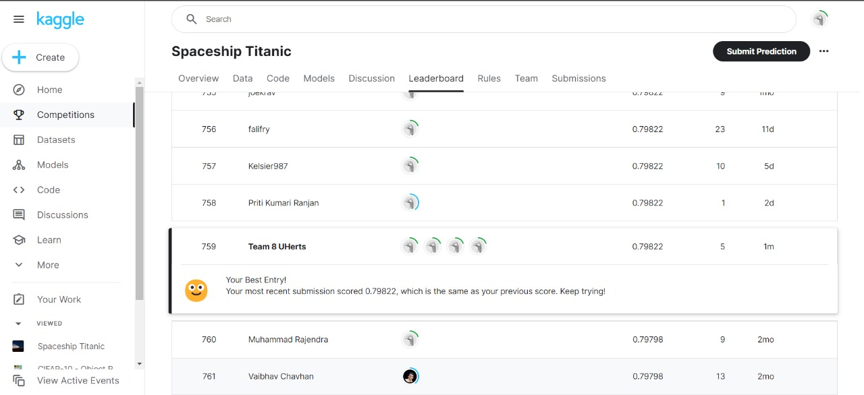
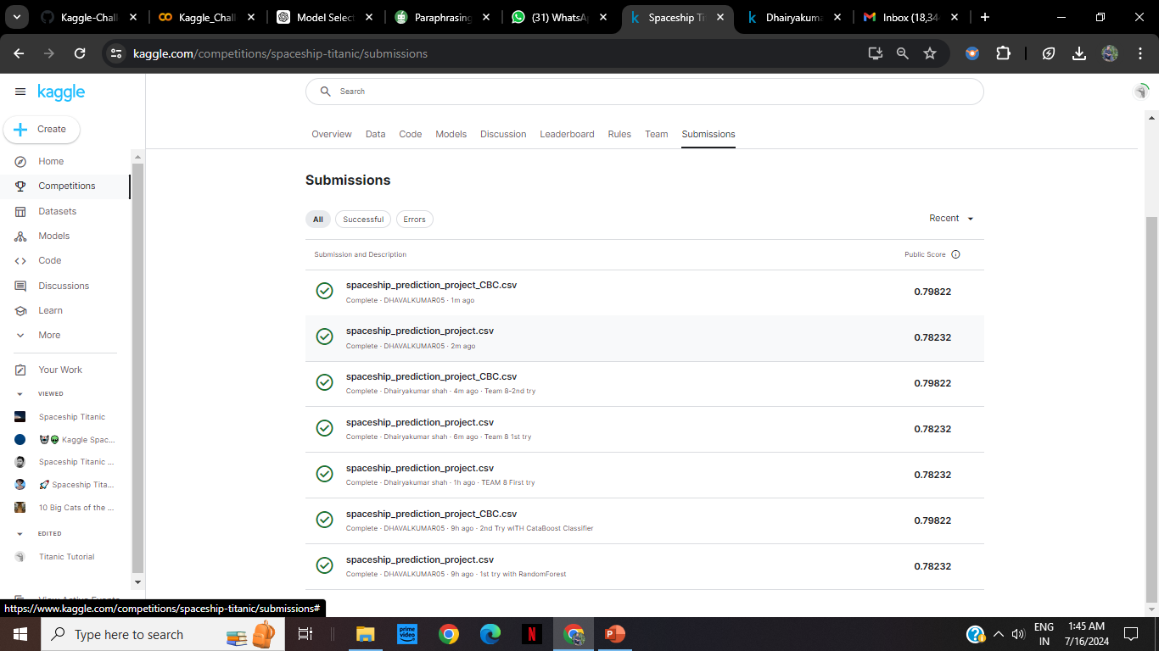
Some insights of Kaggle challenge submission

Slide 16
Thank you!

